Slide 1
Access Check
@NYCDisabilities
NYC.gov/disability

Slide 2
Accessible Communications Documents, Slide Decks and Emails
@NYCDisabilities
NYC.gov/disability

Slide 3
Outline
Creating accessible electronic documents
Creating accessible slide decks
Creating accessible emails
@NYCDisabilities
NYC.gov/disability

Slide 4
Creating Accessible Documents Overview
Visual Design
Fonts
Color Contrast
Images
Formatting
Content
@NYCDisabilities
NYC.gov/disability

Slide 5
Documents: Font Accessibility
Minimum Font Size: 12 Points
Large Print Font Size: 18 Points
Use Accessible Fonts from Sanserif Family
Arial
Verdana
Tahoma
Helvetica
Calibri
@NYCDisabilities
NYC.gov/disability

Slide 6
Documents: Color Contrast
The color contrast between any text and its background needs to have a ratio of 4.5:1
Use color contrast checkers
Webaim Color Contrast Checker - https://webaim.org/resources/contrastchecker/
@NYCDisabilities
NYC.gov/disability

Slide 7
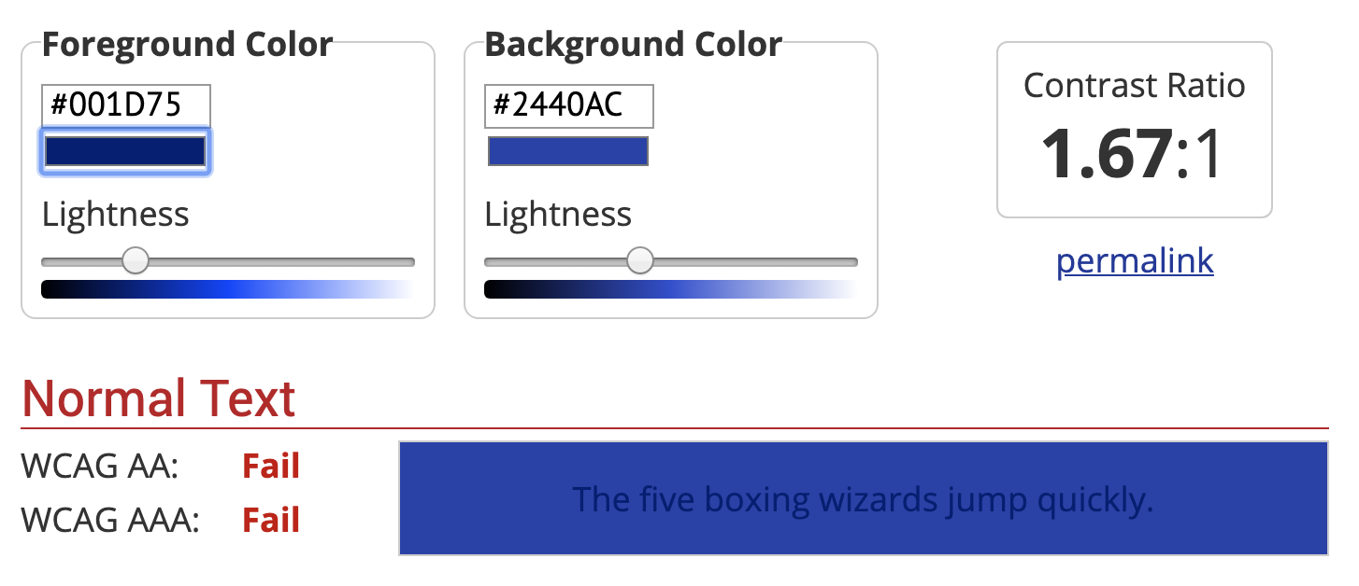
Color Contrast Checker (Bad)
@NYCDisabilities
NYC.gov/disability

Slide 8
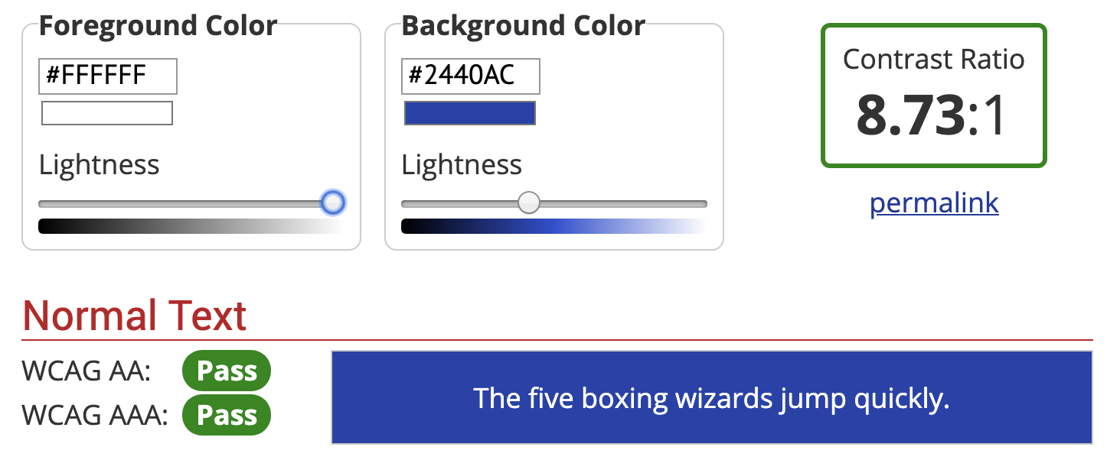
Color Contrast Checker (Good)
@NYCDisabilities
NYC.gov/disability

Slide 9
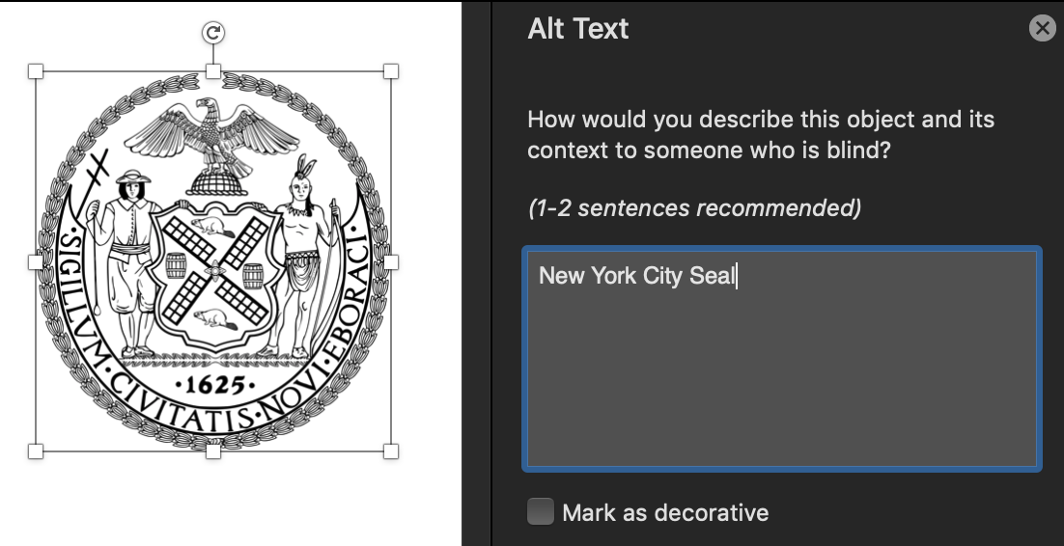
Documents: Images
All images need to have a text description
Select the image
Right click and choose “Edit alt text” (Office 365)
Add your description in the “Description” field
Note: in previous versions of Microsoft Office, the “Title” field is not as important as the description field.
@NYCDisabilities
NYC.gov/disability

Slide 10
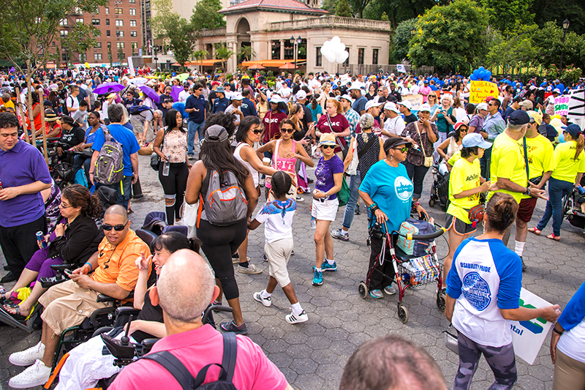
Documents: Describing Images
Ask yourself:
Where does this take place?
When is it happening?
Who is in the image?
What are they doing?
Why are you using this image?
@NYCDisabilities
NYC.gov/disability

Slide 11
Documents: Describing Images (Tips)
For logos, include the name and logo.
Space out acronyms like this “N Y C Mayor’s Office for People with Disabilities logo”
For graphs and pie charts, include the name, what it is conveying and some trends such as highest point or lowest point
For infographics, briefly describe the images and focus on the message that the infographic is conveying. Include all of the text that is in the image in your alt-text
For decorative images insert a blank alt-text and they will be ignored by assistive technologies
@NYCDisabilities
NYC.gov/disability

Slide 12
Documents: Formatting
Headings
Lists
Hyperlinks
Tables
Table of contents
Footnotes and Endnotes
@NYCDisabilities
NYC.gov/disability

Slide 13
Documents: Formatting Headings
Use built-in styles because they are accessible
Select the text that you want to format as a heading
In the “Home” tab navigate to the “Styles” pane
Choose an appropriate heading style
Keyboard shortcut: Control, shift and S
Note: Making the Font bold and increasing the font size is not an accessible way of creating a heading
@NYCDisabilities
NYC.gov/disability

Slide 14
Documents: Heading Structures
To enhance navigation for assistive technology users it is important to use the correct heading levels
Heading level 1: used for broad sections of a document such as “Introduction,” “Table of Contents” or the chapter title “Accessibility in NYC”
Heading level 2: Any subsection of a heading level 1. For example, “Accessible Housing” under the chapter “Accessibility in NYC” heading level 1
Heading level 3: Any subsection of a heading level 2. For example, “Progress adding accessible housing” under the “Accessible Housing” heading level 2
Heading level 4, 5, etc: Headings level 4, 5 and 6 should continue to follow the hierarchy in the same fashion
@NYCDisabilities
NYC.gov/disability

Slide 15
Headings Example (None)
@NYCDisabilities
NYC.gov/disability

Slide 16
Headings Example (Added)
@NYCDisabilities
NYC.gov/disability

Slide 17
Documents: Heading Tips
Do not use too many headings: Headings should be used to mark sections of a document that a reader would want to jump to. Formatting too many headings can defeat the purpose of using them for navigation
Do not format list items as headings. Either format something as a list or a heading. Not both
@NYCDisabilities
NYC.gov/disability

Slide 18
Documents: Lists
Use lists to break up large blocks of text
Use the built-in list functionality on the ribbon menu
Place the cursor where you would like to start the list
Go to the “Home” tab
Navigate to the “Paragraph” group
Select the bullets button
@NYCDisabilities
NYC.gov/disability

Slide 19
Documents: Hyperlinks
Make URLS into hyperlinks so that they are easier to access
Select the text that you would like to hyperlink
Right click and choose “Hyperlink”
Paste the URL in the field labelled “Address”
Use the “Text to Display” field to change the text label for the link
Keyboard Shortcut: Press Control + K to add a hyperlink
Note: Use unique and descriptive labels. (Avoid simply Click Here)
@NYCDisabilities
NYC.gov/disability

Slide 20
Documents: Tables
Tables should not be used for layout purposes.
They should only be used to show tabular data
Examples of tabular data include schedules, statistics, charts etc.
@NYCDisabilities
NYC.gov/disability

Slide 21
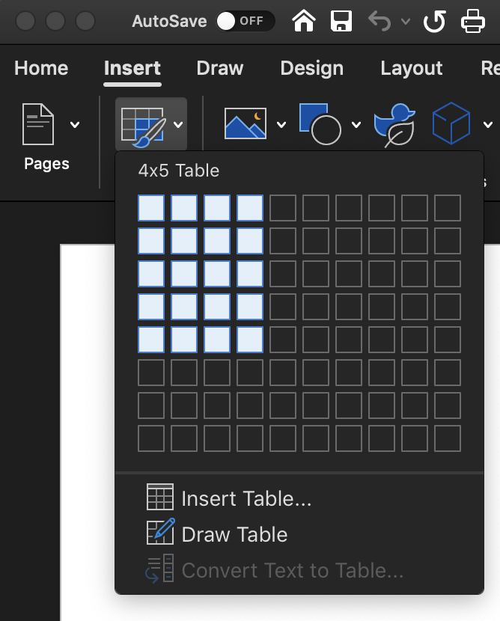
Documents: Create a Table
Go to the Insert Tab
Navigate to the Tables group
Choose the number of columns and Rows
Select ”Insert Table”
@NYCDisabilities
NYC.gov/disability

Slide 22
Documents: Table of Contents
If your document is longer than three pages, a Table of Contents would make it more accessible and easier to navigate
If you have created headings using the heading styles, you can generate a Table of Contents automatically
Go to the “References” tab
Navigate to “Table of Contents”
Choose one of the options
@NYCDisabilities
NYC.gov/disability

Slide 23
Documents: Footnotes and Endnotes
The Footnotes and Endnotes features are accessible and can be used as long as the final document is in Word format
Keep in mind that when saved as PDF Footnotes and Endnotes read out of order
@NYCDisabilities
NYC.gov/disability

Slide 24
Documents: Things to Avoid
The Flow chart feature is not accessible
The Text Box feature is not accessible
Avoid creating complex or nested tables
Avoid using fillable form fields in Microsoft Word
@NYCDisabilities
NYC.gov/disability

Slide 25
Documents: Content
Avoid using all caps except for acronyms
Avoid using large blocks of text
Use lists to break up the content
Use Plain Language
@NYCDisabilities
NYC.gov/disability

Slide 26
Top 10 Principles for Plain Language – Part 1
1. Write for your reader, not yourself.
2. Use pronouns when you can.
3. State your major point(s) first before going into details
4. Stick to your topic.
5. Limit each paragraph to one idea and keep it short.
(Courtesy of the National Archives)
@NYCDisabilities
NYC.gov/disability

Slide 27
Top 10 Principles for Plain Language – Part 2
6. Write in active voice. Use the passive voice only in rare cases.
7. Use short sentences as much as possible.
8. Use everyday words. If you must use technology terms,
explain them on the first reference.
9. Omit unneeded words.
10. Keep the subject and verb close together.
(Courtesy of the National Archives)
@NYCDisabilities
NYC.gov/disability

Slide 28
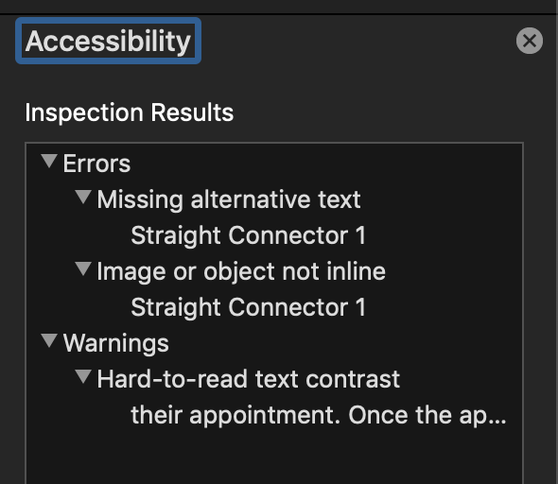
Documents: Accessibility Checker
Always use the “Accessibility Checker” to make sure you haven’t missed anything
Go to the “Review” Tab
Choose “Check Accessibility”
@NYCDisabilities
NYC.gov/disability

Slide 29
Documents: Save As PDF
An accessible Word document can be saved as an accessible PDF
Go to the “File” Tab
Choose “Save As”
Choose destination and fill in the file name
Navigate to “File Type” and choose “PDF”
@NYCDisabilities
NYC.gov/disability

Slide 30
Accessible PDFs Overview
Document Properties
Tagging headings, links, lists and tables
Alt-text for images
Reading order
@NYCDisabilities
NYC.gov/disability

Slide 31
PDF Document Properties
Description --> Title: (Usually the <H1>)
Initial View --> Page Layout: Single Page Continuous
Initial View --> Window Options, Show: Document Title
Advanced --> Language: English
@NYCDisabilities
NYC.gov/disability

Slide 32
Tagging PDFS Using Acrobat Pro
Content Panel in Navigation Pane on left
Arranging content and Artifacting
Tags Panel in Navigation Pane on left
Setting tag structure and use of appropriate tags
@NYCDisabilities
NYC.gov/disability

Slide 33
Alt-Text for Images
All decorative graphics must be Artifacted
All meaningful graphics use <Figure> tag
All <Figure>’s need Alternative Text
@NYCDisabilities
NYC.gov/disability

Slide 34
Reading Order
Order of Content Containers and Tags should be the same
This order should match the logical flow of the text in the document
@NYCDisabilities
NYC.gov/disability

Slide 35
Accessible Slide Decks Overview
Accessible Templates
Fonts
Color Contrast
Images
Reading order
Content
@NYCDisabilities
NYC.gov/disability

Slide 36
Slide Decks: Use Accessible Slide Layouts
Not all slide layouts are accessible
If your entire slide is an image with text in it, it is less likely to be accessible
Use proper title and body fields
Accessible PowerPoint Template Sampler
@NYCDisabilities
NYC.gov/disability

Slide 37
Slide Decks: Font Accessibility
Minimum Font Size: 24 Points
Use Accessible Fonts from Sanserif Family
Arial
Verdana
Tahoma
Helvetica
Calibri
@NYCDisabilities
NYC.gov/disability

Slide 38
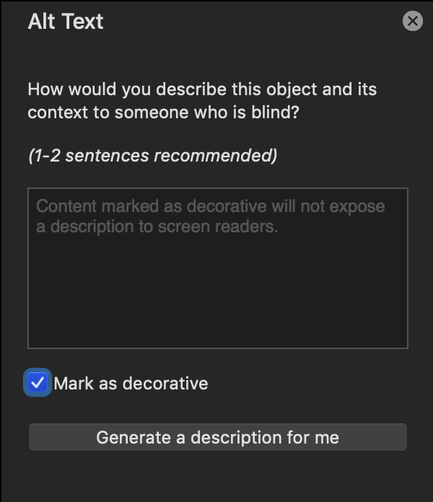
Slide Decks: Images Tips
Use Alt Text to describe important images and logos
Images that have no meaning should be marked as decorative in the “Alt-text Pane”
@NYCDisabilities
NYC.gov/disability

Slide 39
Slide Decks: Reading Order
Ensure that your slides will be read by a screen reader in a logical order by using the “Selection Pane”
In the “Home tab,” navigate to the “Drawing group”
Choose “Arrange” and then “Selection Pane”
Screen readers will move through the information in reverse order
Make sure that the title is the last item on bottom
The body and relevant images should also be near the bottom
Repeating content such as logos, Twitter handles and website addresses should be at the top
@NYCDisabilities
NYC.gov/disability

Slide 40
Slide Decks: Content
Avoid using all caps except for acronyms
Avoid using large blocks of text
Use lists to break up the content
Tables are difficult to read for assistive technology users. If there is a table include an accessible version of the table as a Word document
Use Plain Language
@NYCDisabilities
NYC.gov/disability

Slide 41
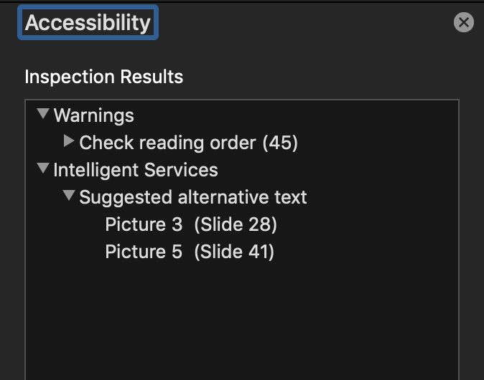
Slide Decks: Accessibility Checker
Always use the “Accessibility Checker” to make sure you haven’t missed anything
Go to the “Review” Tab
Choose “Check Accessibility”
@NYCDisabilities
NYC.gov/disability

Slide 42
Accessible Emails Overview
Fonts
Images
Color Contrast
Content
@NYCDisabilities
NYC.gov/disability

Slide 43
Emails: (Layout)
Avoid using tables to set the layout of your email messages
@NYCDisabilities
NYC.gov/disability

Slide 44
Emails: Describing Images (Tips)
Be clear and concise. Try to keep all descriptions under three sentences long
For logos you can label it with the organization name and be sure to space out acronyms.
Example: N Y C M O P D logo
If the image is an event invitation or flyer, include all text that is in the image
Do not forget to add alt-text to images in your e-mail signature
@NYCDisabilities
NYC.gov/disability

Slide 45
Thank you
Walei Sabry
Digital Accessibility Coordinator
wsabry@doitt.nyc.gov
Arthur Jacobs
Housing Coordinator
ajacobs2@cityhall.nyc.gov
Jon Novick
Outreach Manager
jnovick@cityhall.nyc.gov
@NYCDisabilities
NYC.gov/disability

